Slide 1
Multithreading In Java
Charvi Mehra | Shweta Meena

Slide 2


Program and Process
Add.java
Hard Disk
//pseudocode
class Add{
public static int sum(int a, int b){
int sum = a + b;
return sum;
}
public static void main(String[] args){
int a = 10;
int b = 20;
int sum = sum(a,b);
System.out.println("Sum : "+sum);
}
}
Program
Executing
RAM
Process
Notes:
For example, we have a code to add two numbers in java. This program is stored in the hard disk and while executing it moves to the RAM and is the process being executed.
Ok ok

Slide 3


Step, Task and Process
Step 1
Step 1
Task 1
Task1
Task2
Task3
Task4
Task5
Step 2
Step 3
Process 1
Step 4
Task6
Task7
Task8
Task9
Task 2
Task10
Step 5
Step 6
Step 7
Task 3
A process involves multiple tasks and these tasks are performed by their threads. These threads store the data and code and have its own local variables and memory. A process doesn’t share data directly with another process that is why a thread is also called a light weight process.
Step 8
Step 9
Process 2
Step 10
Step 11
Task 4
Step 12
Notes:
To start first we need to understand what is a step, task and a process. A task comprises of a set of steps. ….(start animation show steeps). So you do this step this step and so on and you’ve accomplished a certain thing or a certain task and multiple tasks make up a process and that’s all what you need to know for now. So talking about threads? Threads are what perform these tasks (…….start thread animation). Explain written.
Context:
https://www.youtube.com/watch?v=S03z7Uy2su0&list=PLbR6veOCuUYnu9Mjn7OwQlgMrQrvPtdZp&index=2
https://www.youtube.com/watch?v=FvN5BWrEWx0&list=PLbR6veOCuUYnu9Mjn7OwQlgMrQrvPtdZp&index=3

Slide 4

What is a Java thread?
Thread is a light weighted sub-process. It contains a separate path of execution.
Every Java program contains at least one thread.
A thread is created and controlled by the java.lang.Thread class.
In a thread-based multitasking environment, the thread is the smallest unit of dispatchable code. ​This means that a single program can perform two or more tasks simultaneously. ​
For instance, a text editor can format text at the same time that it is printing, as long as these two actions are being performed by two separate threads.
Notes:
Whatever image or diagram you think is relevant add it please. Agar koi diagram aisa hai jo ban jayega tell me I’ll make it here. Also colours and formatting agar kuch better idea hai toh krde. Also if you want arrange the pints in relevant order.
Done!

Slide 5

Types of multi-tasking
Process Based
Thread Based
In process-based multitasking, a program is the smallest unit of code that can be dispatched by the scheduler.​
Process- based -> process-based multitasking is the feature that allows your computer to run two or more programs concurrently. ​​
For example, process-based multitasking enables you to run the Java compiler at the same time that you are using a text editor.
Thus, process-based multitasking deals with the “big picture,” and thread-based multitasking handles the details.​
Multitasking threads require less overhead than multitasking processes, Processes are heavyweight tasks that require their own separate address spaces.​
In a thread-based multitasking environment, the thread is the smallest unit of dispatchable code. ​
This means that a single program can perform two or more tasks simultaneously. ​
For instance, a text editor can format text at the same time that it is printing, as long as these two actions are being performed by two separate threads. ​
Notes:
Colour scheme main I have doubts toh better ho kuch toh krdio. Added some animations related to first second point might add more for thire agar time hua
Third wala kiske liye ??
Charvi: mtlb?.....third point mtlb example k liye bhi animated images bna skti hu agar time hua

Slide 6
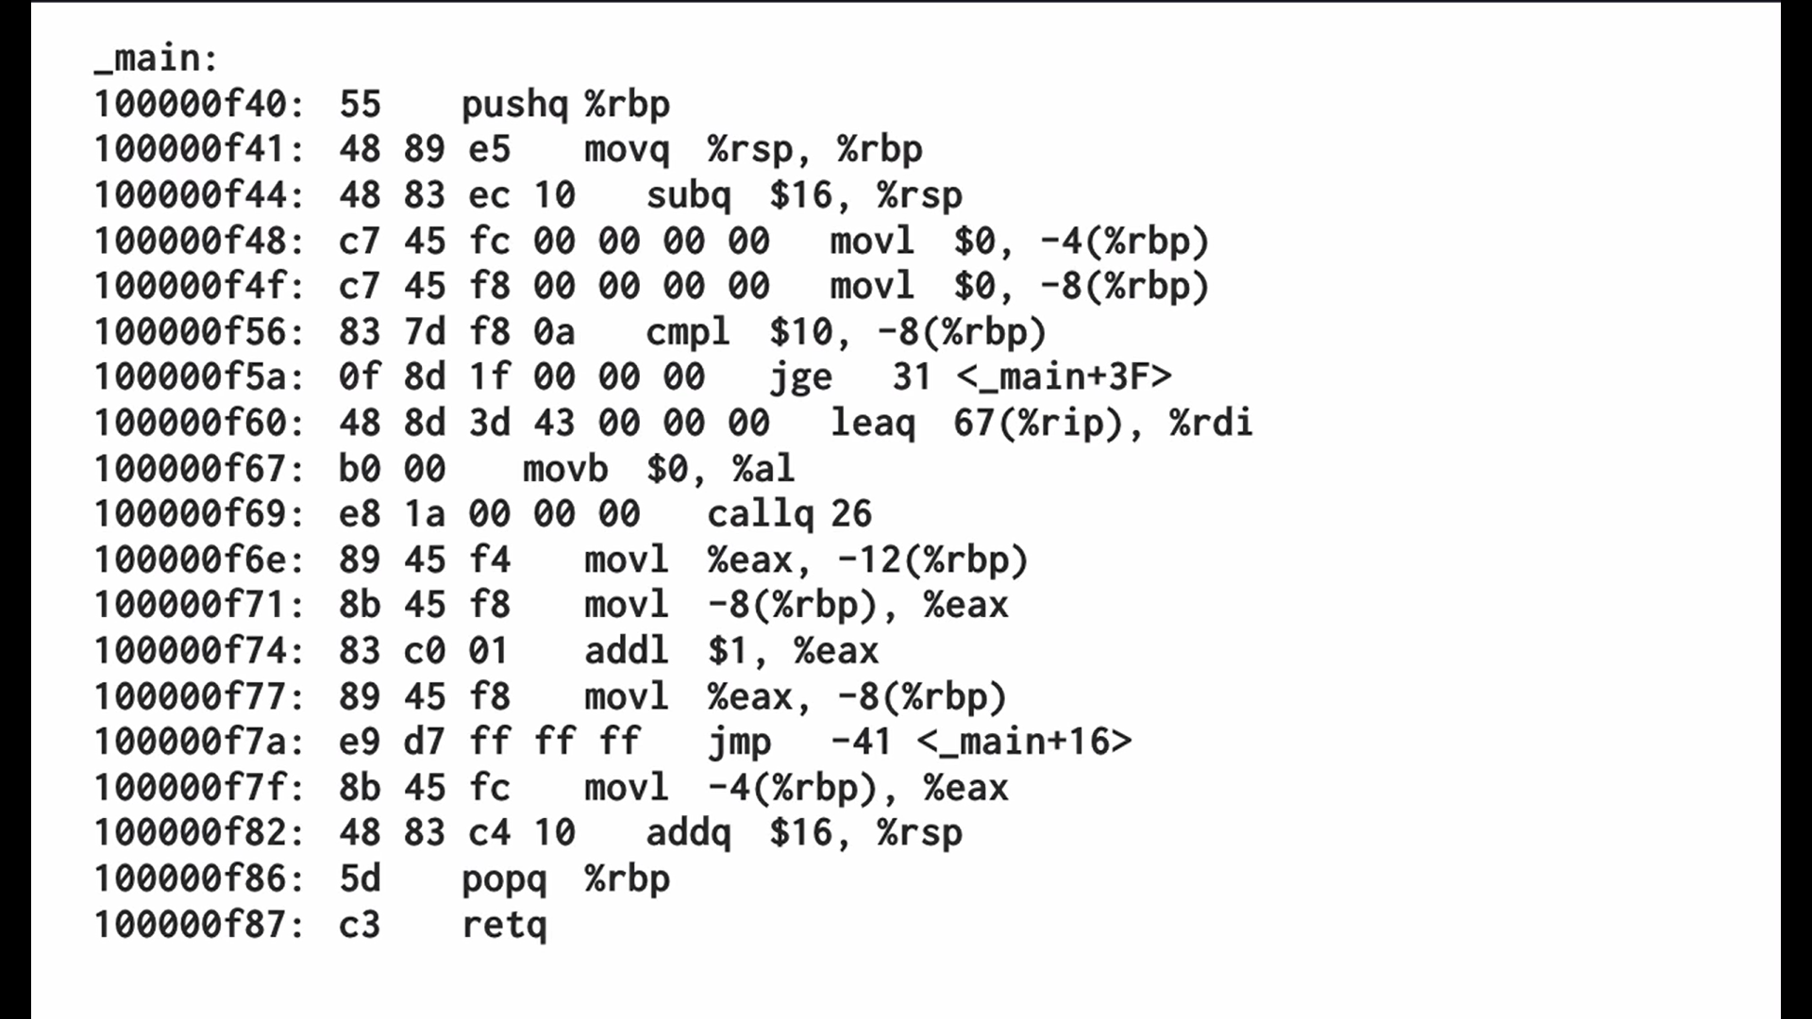
Types of Thread Process
Process
Add.java
Code
//pseudocode
class Add{
public static int sum(int a, int b){
int sum = a + b;
return sum;
}
public static void main(String[] args){
int a = 10;
int b = 20;
int sum = sum(a,b);
System.out.println("Sum : "+sum);
}
}
Data
Files
Registers
Stack
Notes:
As said a process is an executing program which has code to be executed, relevant data and files with variables, a register and a stack. The code is compiled as with the instructions and when we compile it, it is going to look like this. As it runs the instructions are pulled of the memory and executed there are two more important parts of a process (animation pointer)- the program pointer that points towards the part of the program being executed and as the program runs this pointer capture the location of the instruction by the register. A stack keeps track of the depth of the program EXAMPLE IS ME PEHLE WO SUM Function dekhega point krega function call krega wapis aayega print krega toh yeh sab stack mai store hoga.
Okk okk!
Iski position dekh liyo ek baar!
Charvi: mtlb overall slides mai position?

Slide 7
Types of Thread Process
Process
Single Thread Process
Code
Code
Data
Files
Data
Files
Registers
Registers
Stack
Stack
Notes:
Each thread has its own stack and registers

Slide 8
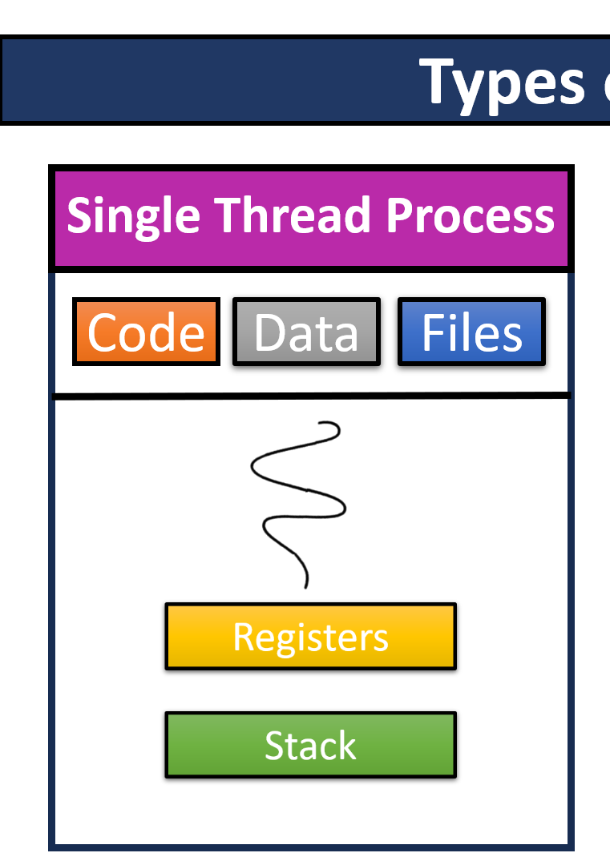
Types of Thread Process
Single Thread Process
Multi Thread Process
Code
Data
Files
Code
Data
Files
Registers
Registers
Registers
Stack
Stack
Stack
Notes:
Each thread has its own stack and registers a single thread bla bla bla please add notes and animations can be improved.
sequential (or single-threaded) program is one that, when executed, has only one single flow of control.
i.e., at any time instant, there is at most only one instruction (or statement or execution point) that is being executed in the program.
A multi-threaded program is one that can have multiple flows of control when executed.
At some time instance, there may exist multiple instructions or execution points) that are being executed in the program
Ex: in a Web browser we may do the following tasks at the same time:
1. scroll a page,
2. download an applet or image,
3. play sound,
4 print a page.
A thread is a single sequential flow of control within a program.
Yeh sab points isi slide mai explain krdenge

Slide 9
Thread Lifecycle - Thread States
New
A thread enters this state when it is temporarily in an inactive state i.e. it is still alive but it is not eligible to run. It can be in a waiting, sleeping, or blocked state.
A new thread begins its life cycle in this state and remains here until the program starts the thread. It is also known as the born thread.
Runnable
Once a newly born thread starts, the thread comes under a runnable state. A thread stays in its state until it is executing its task.
Waiting
Running
In this state, a thread starts executing by entering the run() method, and the yield() method can send them back to the Runnable state.
A runnable thread enters the terminated state when it completes its task or otherwise terminates.
Terminated
Notes:
A Java thread can lie only in one of the shown states at any point of time.

Slide 10
Thread Lifecycle – Creating a thread
A thread in Java can be created in two ways
Thread Class
Runnable Interface
public class Thread
extends Object
public interface Runnable
implements Runnable
Notes:
Need of a thread?

Slide 11
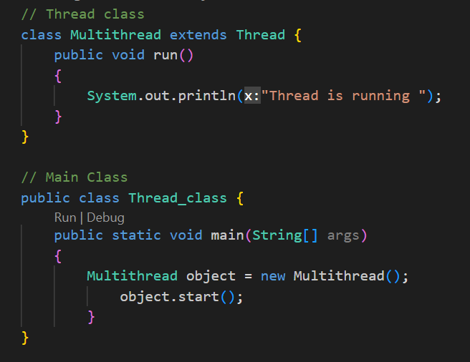
Thread class
Create a Thread class
Override run() method
Create object of the class
Invoke start() method to execute the custom threads run()

Slide 12
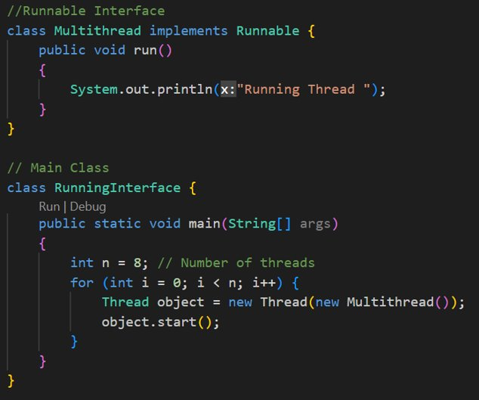
Runnable Interface
Create a Thread class implementing Runnable Interface.
Override run() method
Create object of the class
Invoke start() method to using the object.

Slide 13
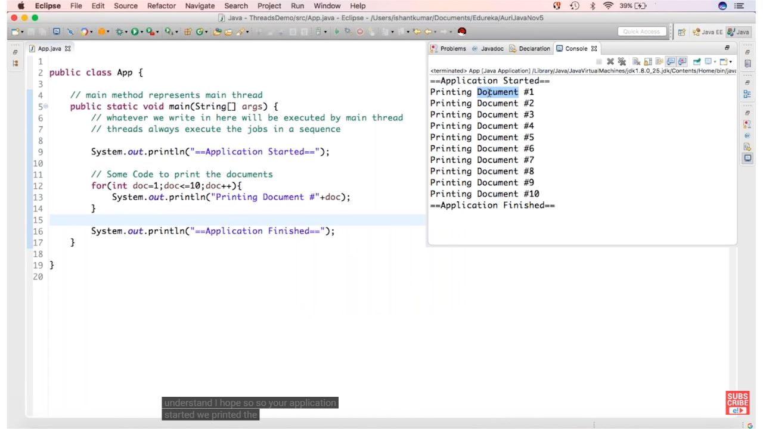

Slide 14
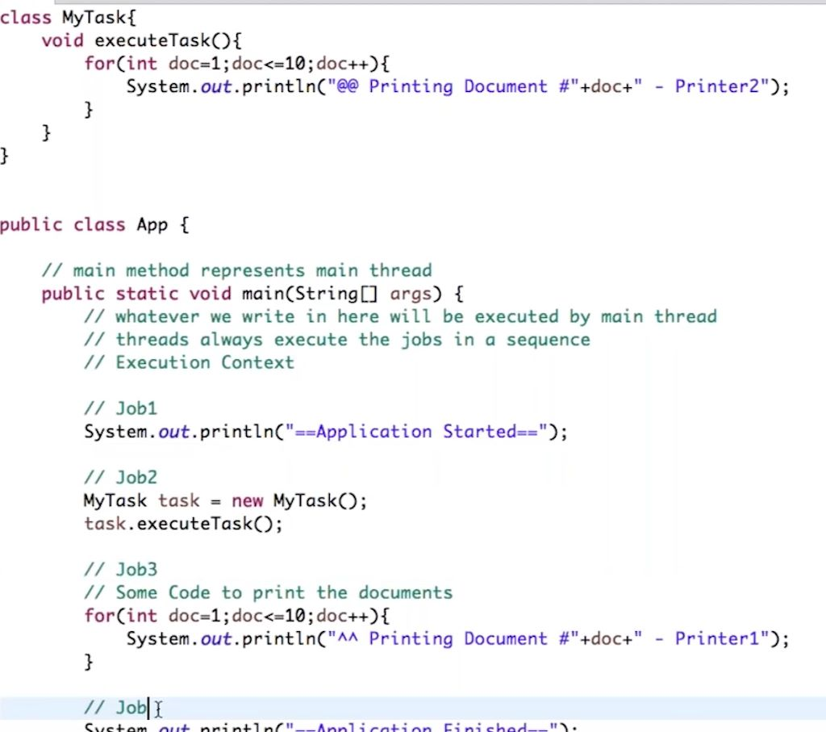

Slide 15
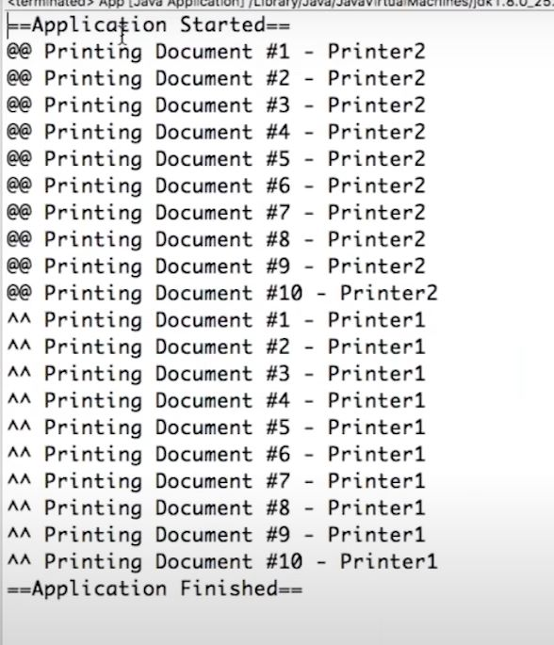
Output

Slide 16
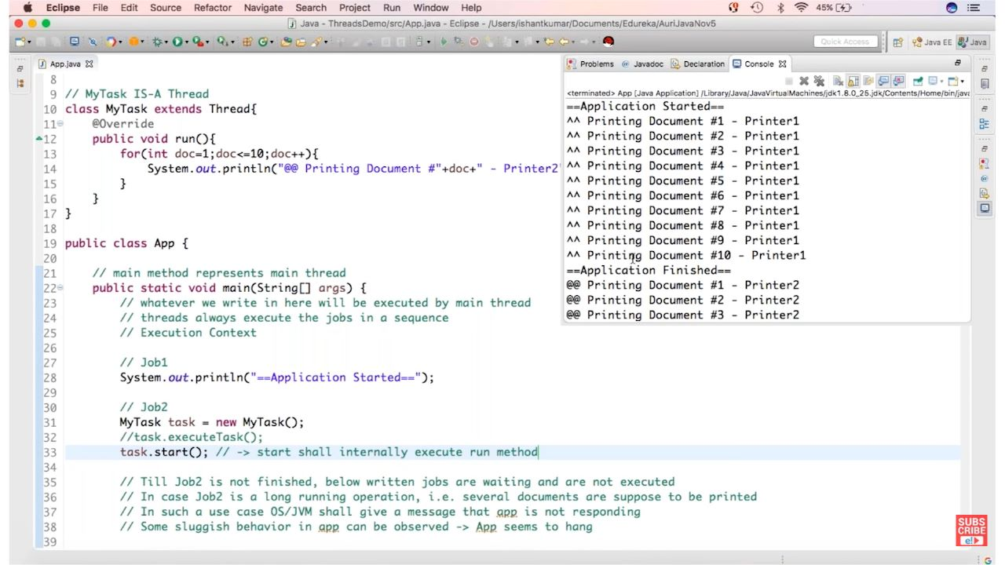

Slide 17

Java Main Thread
When a Java program starts up, one thread begins running immediately. ​
This is usually called the main thread of your program, because it is the one that is executed when your program begins.
The main thread is important for two reasons:​
It is the thread from which other “child” threads will be spawned.​
2. Often, it must be the last thread to finish execution because it performs various shutdown actions.​
main

Slide 18
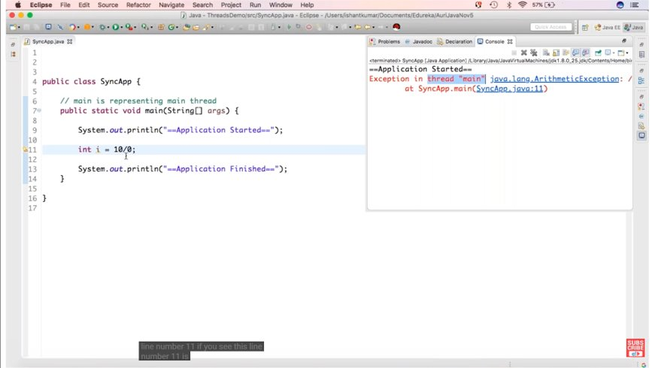
Notes:
Java provides a cleaner solution, there is no class “Monitor”; instead, each object has its own implicit monitor that is automatically entered when one of the object’s synchronized methods is called.

Slide 19
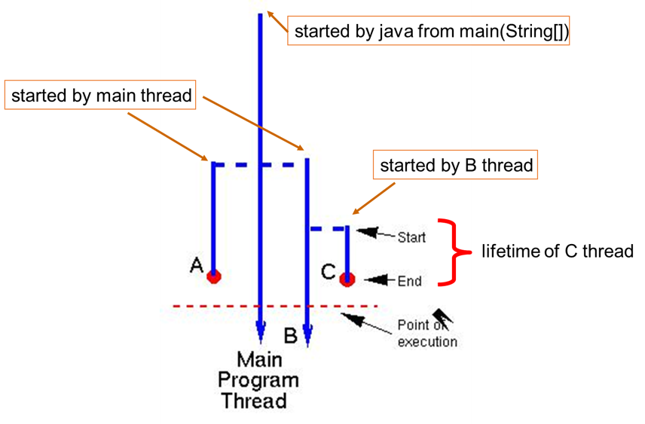
Multi-threading is the ability of a program to run two or more threads concurrently, where each thread can handle a different task at the same time making optimal use of the available resources.

Slide 20
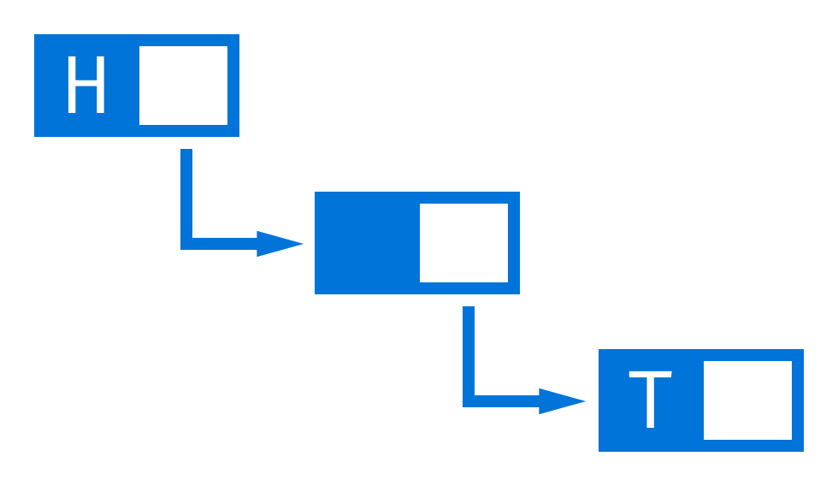
Synchronization
Thread 2
Thread 2
Thread 1
Thread 1
Notes:
For example, if we want two threads to communicate and share a complicated data structure, such as a linked list, we need some way to ensure that they don’t conflict with each other. ​
That is, we must prevent one thread from writing data while another thread is in the middle of reading it. ​

Slide 21

Synchronization
Thread 3
Thread 2
Thread 1
Thread 5
Thread 4
Notes:
Once a thread enters a monitor, all other threads must wait until that thread exits the monitor. ​
In this way, a monitor can be used to protect a shared asset from being manipulated by more than one thread at a time. ​

Slide 22
Methods
Method | Meaning
getName | Obtain a thread’s name.
getPriority | Obtain a thread’s priority.
isAlive | Determine if a thread is still running.
join | Wait for a thread to terminate.
run | Entry point for the thread.
sleep | Suspend a thread for a period of time.
start | Start a thread by calling its run method.

Slide 23
Thread Priorities
Thread 1
1
Thread 2
3
Thread 3
2
Thread 4
2
Thread priorities are used by the thread scheduler to decide when each thread should be allowed to run.
Theoretically , higher-priority threads get more CPU time than lower-priority threads.
A higher-priority thread can also preempt a lower-priority one.
To set a thread’s priority, use the setPriority( ) method, which is a member of Thread.

Slide 24
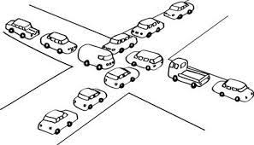
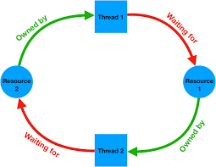
Dead Lock
A special type of error that we all need to avoid that relates specifically to multitasking is deadlock, which occurs when two threads have a circular dependency on a pair of synchronized objects.
Deadlock is a difficult error to debug for two reasons:
It occurs only rarely, when the two threads time-slice in just the right way.
It may involve more than two threads and two synchronized objects.
That is, deadlock can occur through a more simple sequence of events making dependencies on each other.

Slide 25
